Slide 1
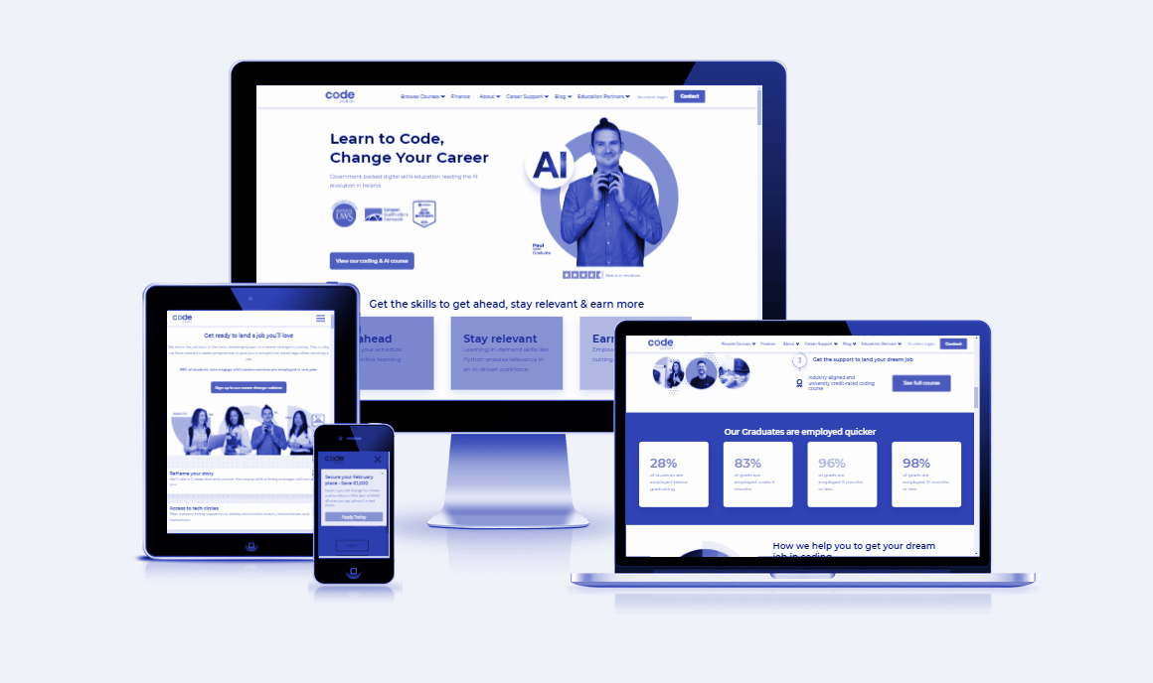

Hackathon 3 -The Kids Books Review!
Team: Dev1- Neeru Dev2- Suba Dev3- Yu Grace
Dev3- Suraj
Notes:
Team Lead: Hi everyone. We are TEAM NAME composed of myself, Dev2 and Dev 3. We’d like to talk about our project PROJECT NAME TECHSTACK(HTML/BOOTSTRAP/JS/CSS/API) & TAGLINE

Slide 2
Planning & Design
Ideation
UX Design
Technologies
Purpose: The aim was to build a platform where users, especially parents, can review and discover books for their children.
Target Audience: Parents, teachers, and children’s book enthusiasts.
Business Case: The MVP
Use Case: Provide a centralized place to find honest reviews of children's books, helping users select the best literature for kids.
User Stories:
Easy navigation to find books.
Responsive design for desktop, tablet, and mobile.
Features like sign-up, browse books, and leave reviews.
Interactivity: Users can search for books by title, genre, or age group, and leave their reviews.
Languages & Frameworks
Frontend: HTML, CSS, Bootstrap, JavaScript.
Backend: Django RDMS DB for book data.
Design Tools: Figma for UX/UI design.
Project Management: Agile methodology with Kanban for task management.
Version Control: GitHub for collaboration and code management.
Notes:
Team Lead discusses the following 1 minute

Slide 3
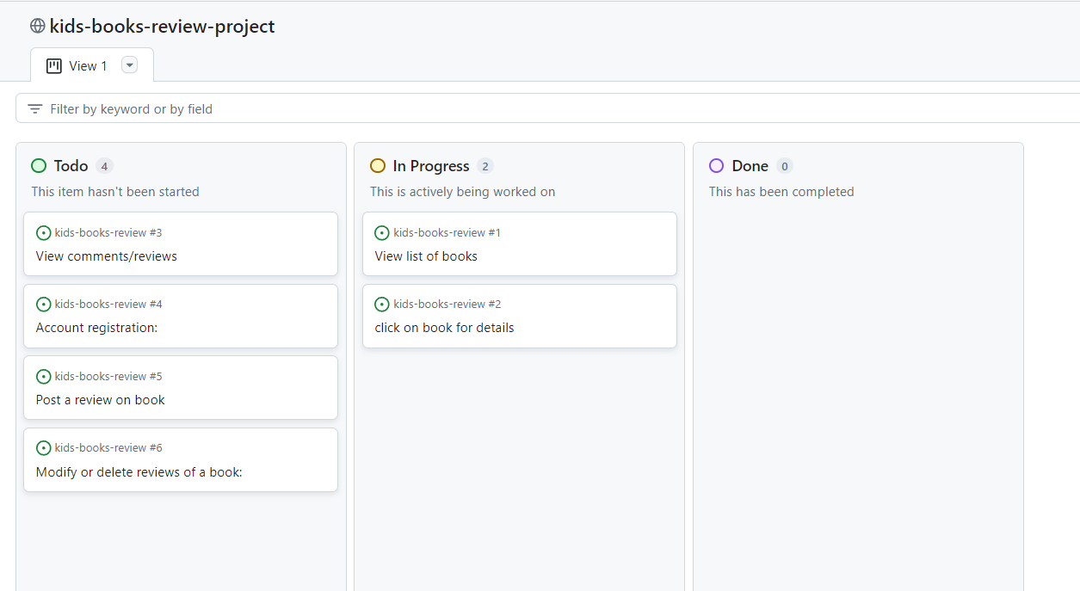
Project Board
Number of User Stories: 9 Assigned Tasks: 6
MoSCoW Prioritisation: 6
AGILE (MVP): 6
Notes:
Team Lead discusses the Project board 30 seconds! Introduces Dev 2

Slide 4
Features
Primary Features:
User sign-up and login.
Search books by different criteria.
Write and read reviews.
Responsive design for various devices.
Secondary Features:
Book recommendations based on user’s previous reviews.
Integration with Django RDMS DB for book data..
Notes:
DEV 2 Discusses secondary and tertiary features in this slide. Introduces DEV 3

Slide 5
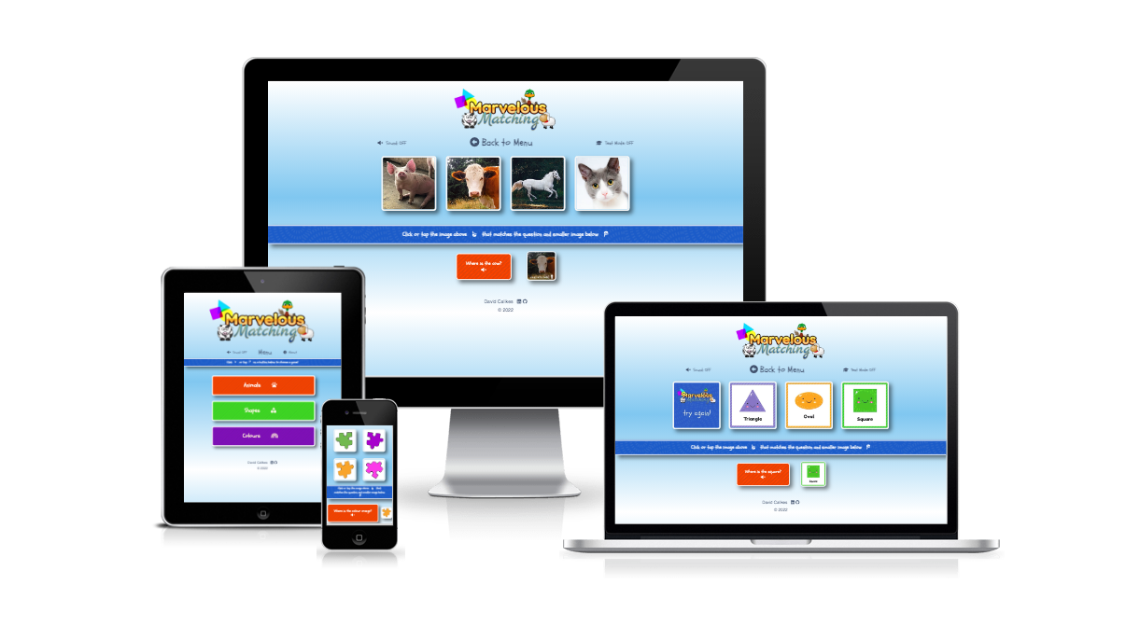
Deployed Project
Deployed Link: The Kids Books Review The Kids Books Review
Hosted on GitHub Pages for easy access and testing.
Deployment Process: Continuous deployment using GitHub Pages and regular updates based on user feedback.
Notes:
Dev 3 opens the link to the deployed project (Mention deployment process via github pages)and exhibits responsiveness, additional features and user experience.1 minute

Slide 6
Documentation, Testing & Version Control
GitHub Repository: GitHub Repository Link
README includes detailed documentation on the setup, usage, and contributions.
Version control managed through GitHub with regular commits and branch management.
Notes:
Dev 3 then opens Repo, and exhibits README touching on testing and deployment

Slide 7
Collaboration & Outcomes
Outcomes
Collaboration
Development Problems
Summary
MVP Success
We are pleased with the initial MVP, which successfully includes the basic features, primarily focusing on weather data retrieval with a basic GUI presentation. The team planning was effective.
Future Enhancements
Expand book categories.
Enhanced Django Model such as Django model classes from a JSON Object
Moving to No-SQL and JSON schema current trends than legacy ORM technologies
Problems Encountered
Scope Clarity: The clearly defined scope of the MVP meant we encountered no significant functionality issues other than those related to weather data.
Managing dynamic data for book reviews and ensuring a consistent user experience across different devices.
Minor Fixes: There are a few small fixes remaining to complete.
Team Dynamics: Excellent collaboration with clear communication and task distribution.
Learning Outcomes: Improved knowledge of Django DB Interaction, responsive design, and project management in a team setting.
Recommendation: Continuation of the project with the addition of new features based on user feedback.
Notes:
All 3 Devs could maybe take a card each here.

Slide 8
Q&A
Notes:
Quick q&a 1 question each from the judges and any questions from the group.

